Slide 1

Study of Divergence of Mammalian Genomes David Bierc Vamsi Chunduri Ashton Dsouza

Slide 2

Aim
The divergence between primates/humans and the following species.
Dog
Mouse
Chimp

Slide 3
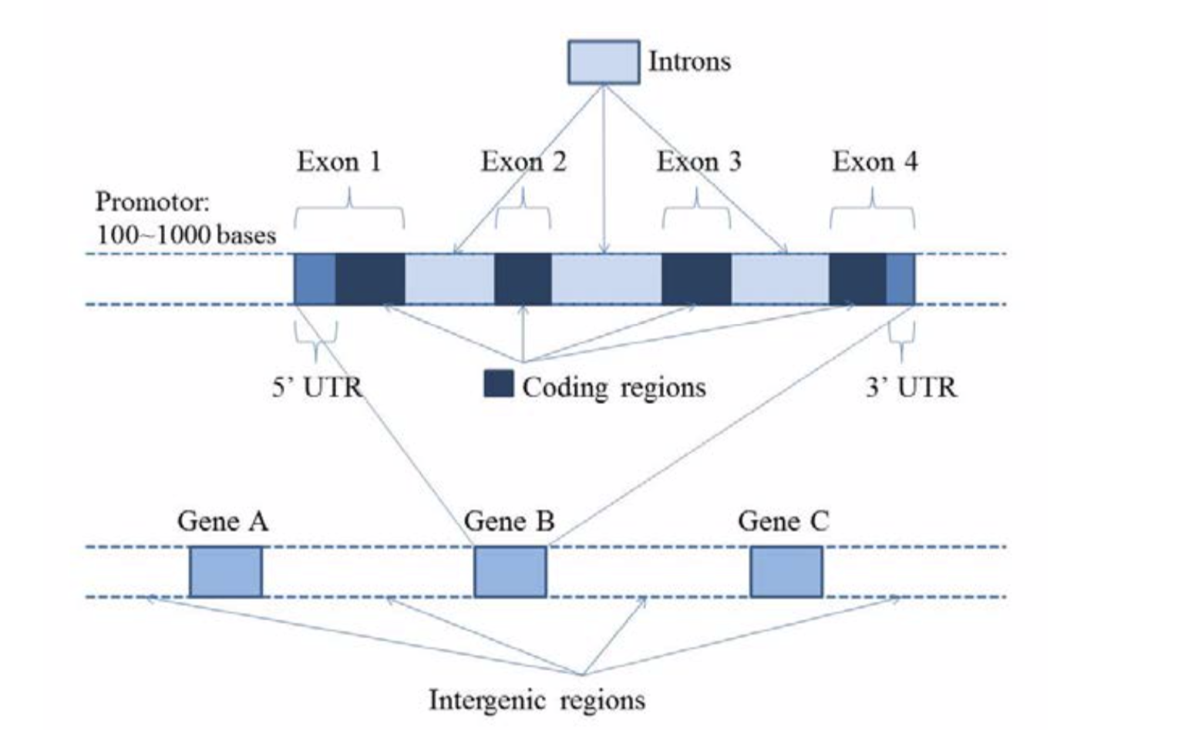
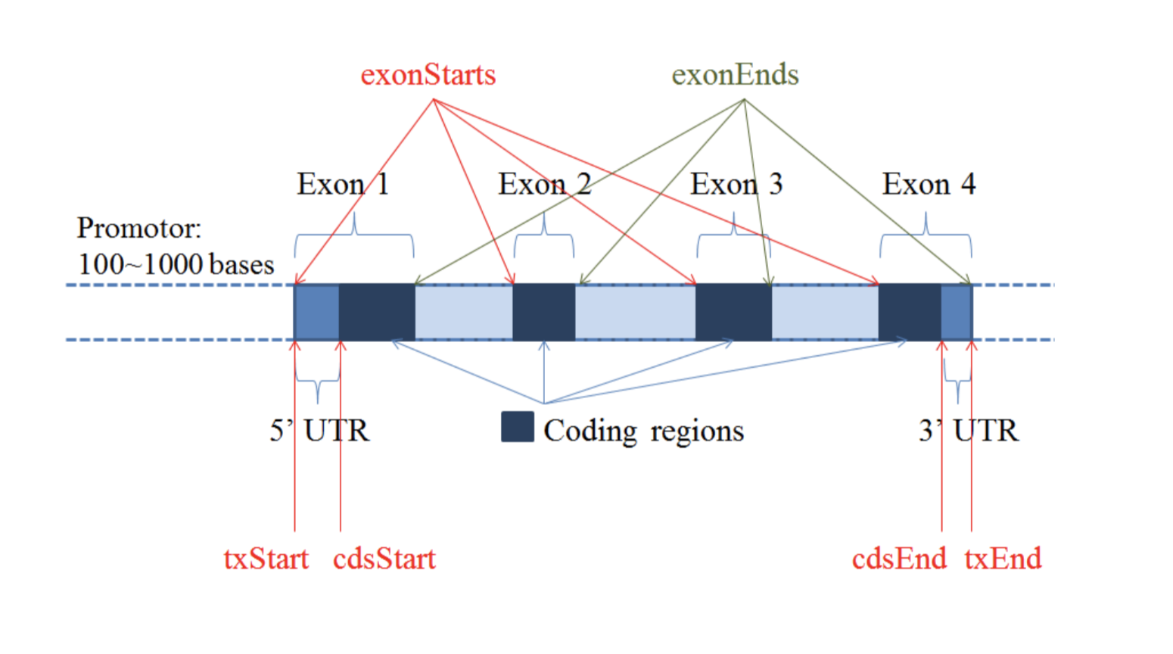
Gene Structure

Slide 4


Project Description
For the following regions:
Compute the substitution rate, Ti/Tv ratio, gap rate and length frequencies
1) Intergenic regions
2) Introns
3) Exons
4) Coding regions
5) 5’ UTRs
6) 3’ UTRs
7) Promotors (considering 100, 200, 400, and 800 bases before first exon.)

Slide 5
File structure
Known Gene File
Maf File

Slide 6
Programming Approach
Create Region class from Known genes file
Construct an array of Regions to use as a lookup table (sort by txStart)
Look at .maf string pair and see if any of the regions overlap the area
Run calculations on proper areas looked up (exons, promotors, introns, intergenic, utr 3, utr 5, and coding regions)
Print and analyze results

Slide 7

Problems Encountered (Lengths)
Length, Human sequence = 601 (only characters in sequence
Sequence Length in program = 622 (expanded with gaps to align properly)
Our solution, cut all gaps from the human sequence while also cutting the other sequence in the same position.
We do this because we are using the known human gene text file

Slide 8
Problem 2 (strand +/-)
Do inversions or mismatches of sequence segments effect calculation?
Both files .maf and Knowngene.txt had strand info with all cases ++,+-,-+,--
Our solution, we just did the calculation for each position completely ignoring strand (+/-).
Why because we were on a time crunch.

Slide 9
Problem 3 (region to region)
How should separated exons be calculated when separated?
Example for an Exon case:
Region: Exon 1: Intron: Exon 2:
Species 1: ACTG- AGCT -GTCA
Species 2: GTCAC GGGG CCAAA
Would you calculate Exon1 and Exon2 together or separate?
Seems to only affect the gap lengths and counts.
Our solution, just run calculations all separate.
Why? Because running out of time and simpler to code for us.

Slide 10
Problem 4 (Overlapping regions)
How should overlapping exons be counted?
Our solution, just count everything that was given.
Why? Because I couldn’t find a justifiable reason to remove overlaps or combine the 3 overlaps into one string. Also not sure what effect it would have on data results.

Slide 11
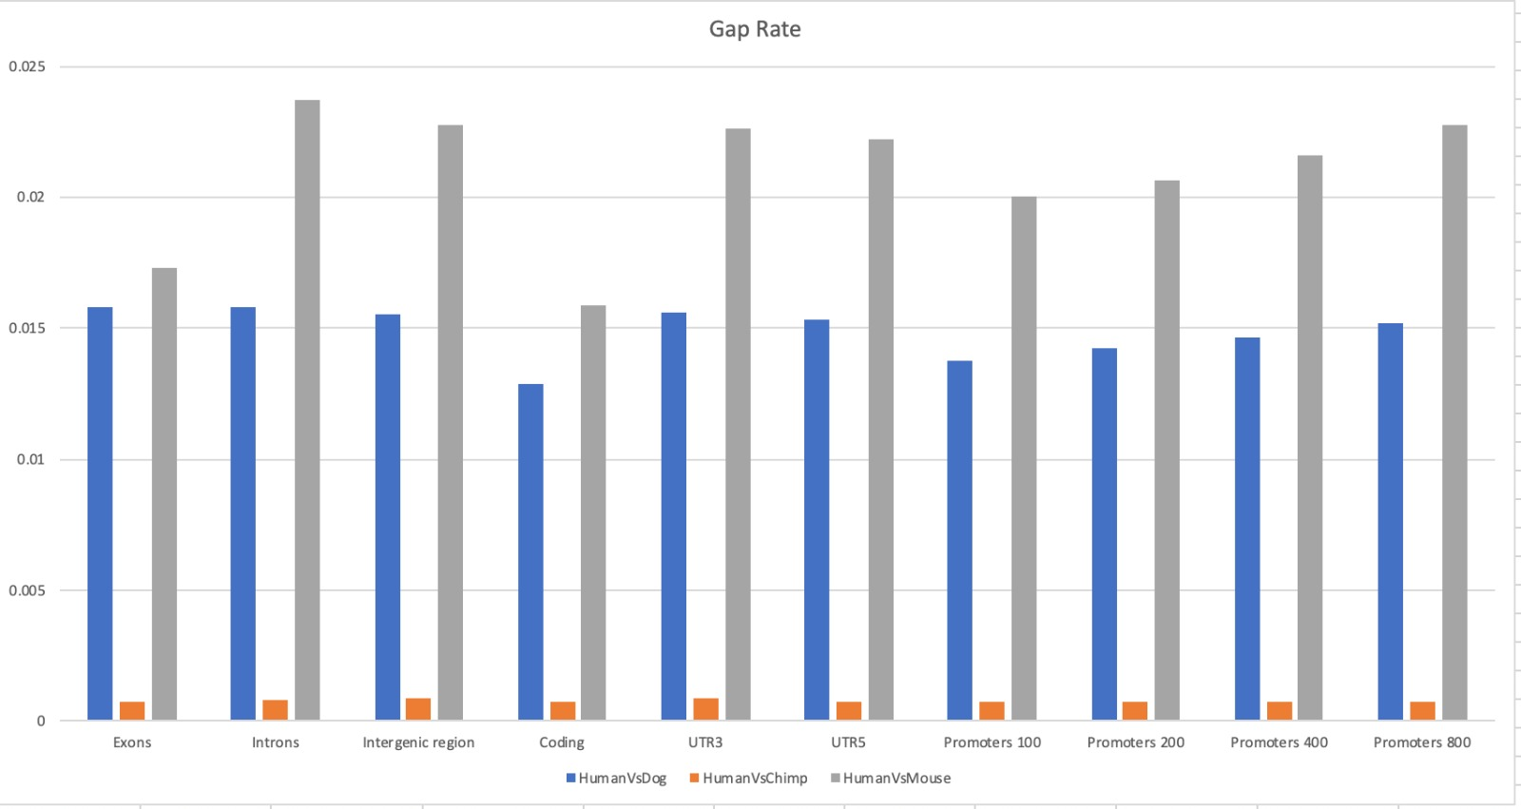
Results. 1) Substitution Rate

Slide 12
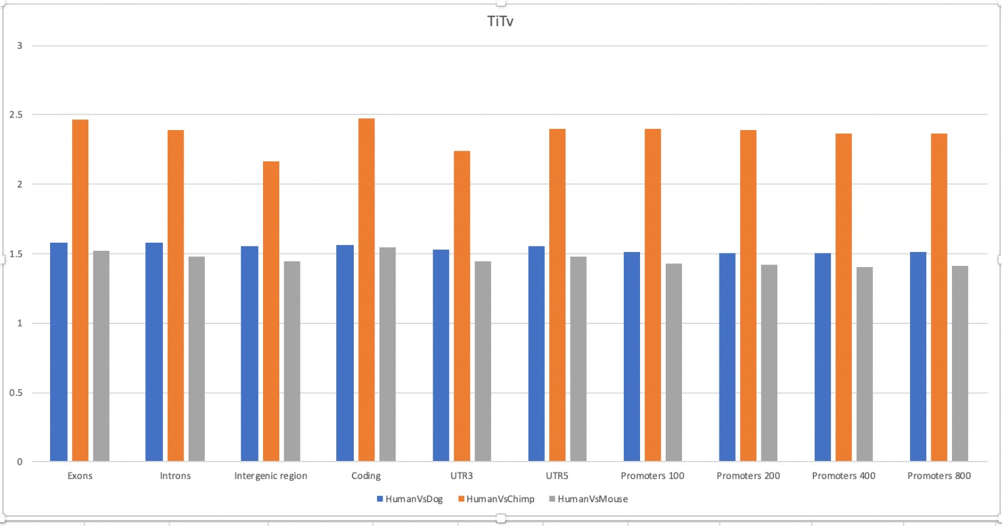
2) Ti / Tv Ratio

Slide 13
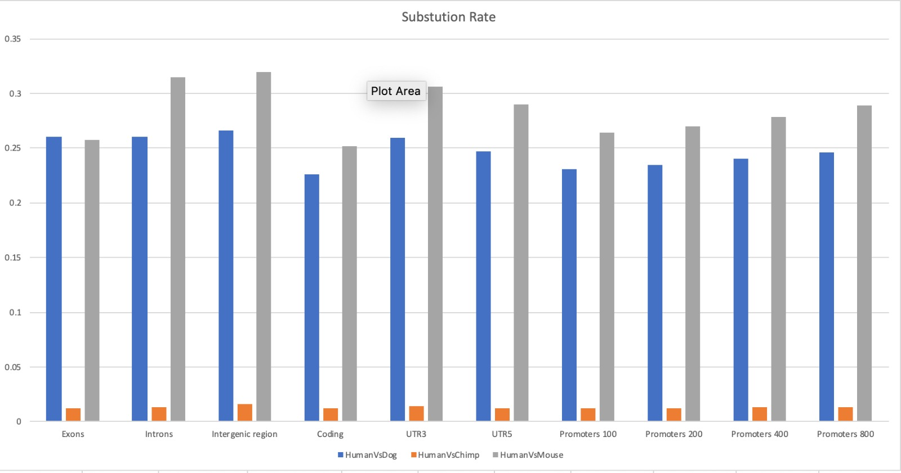
3) Gap Rate

Slide 14
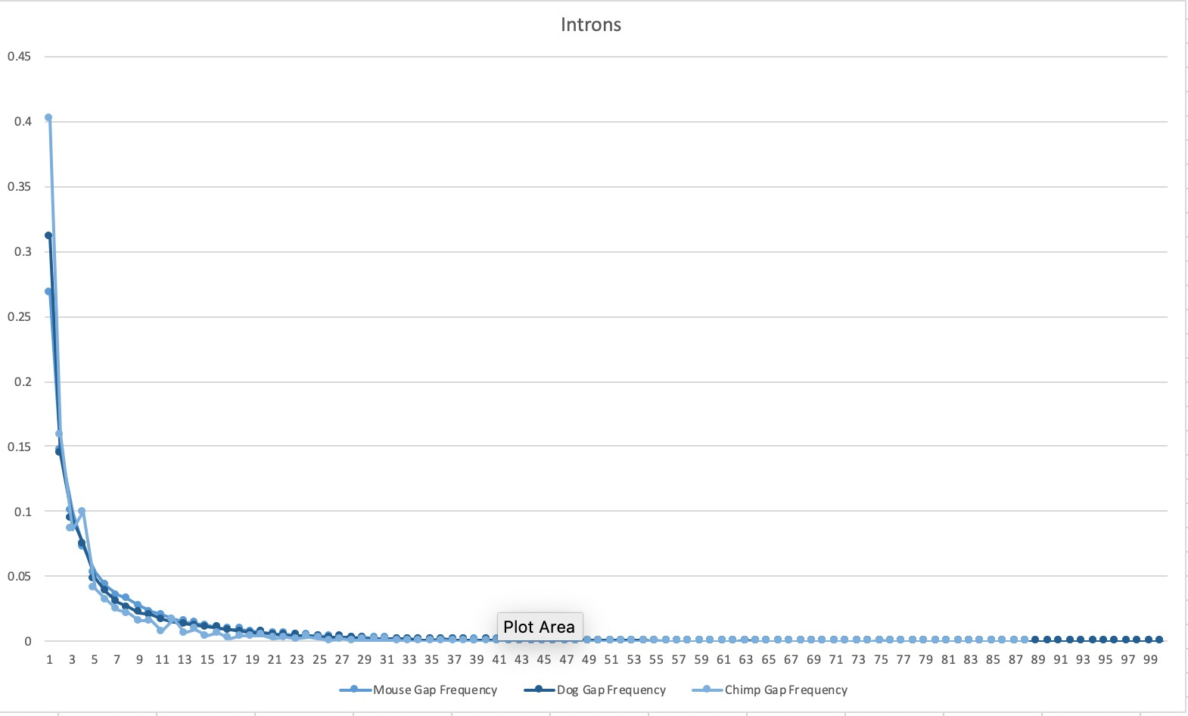
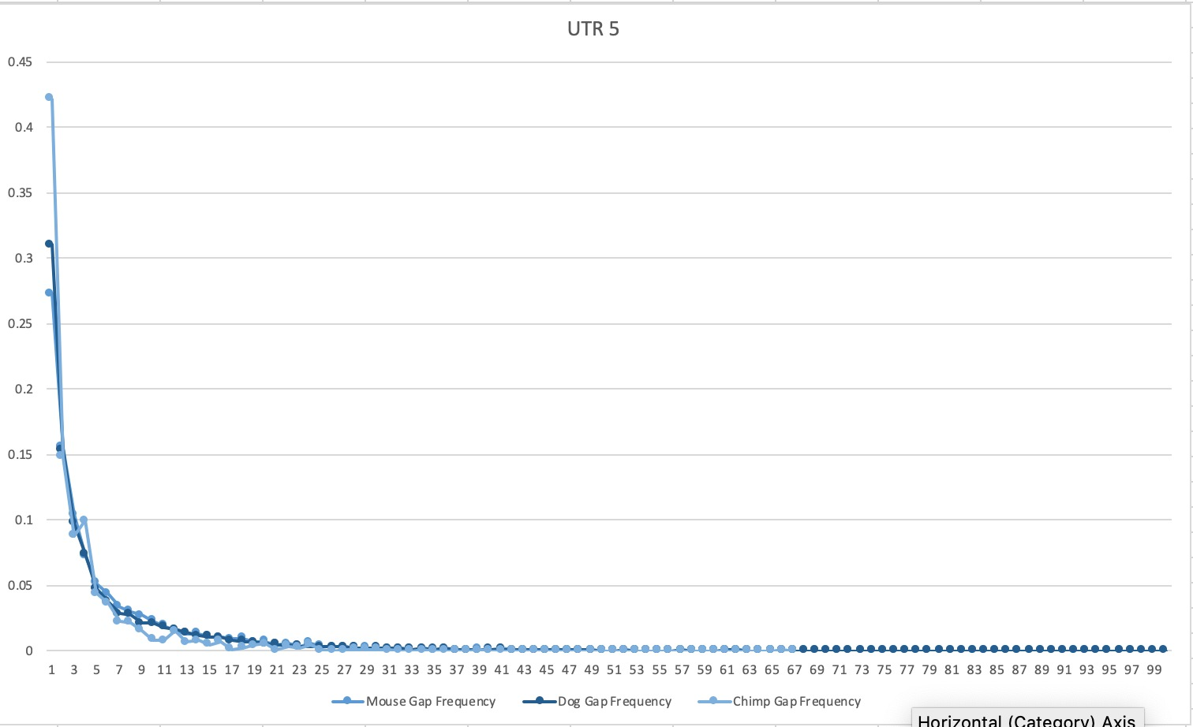
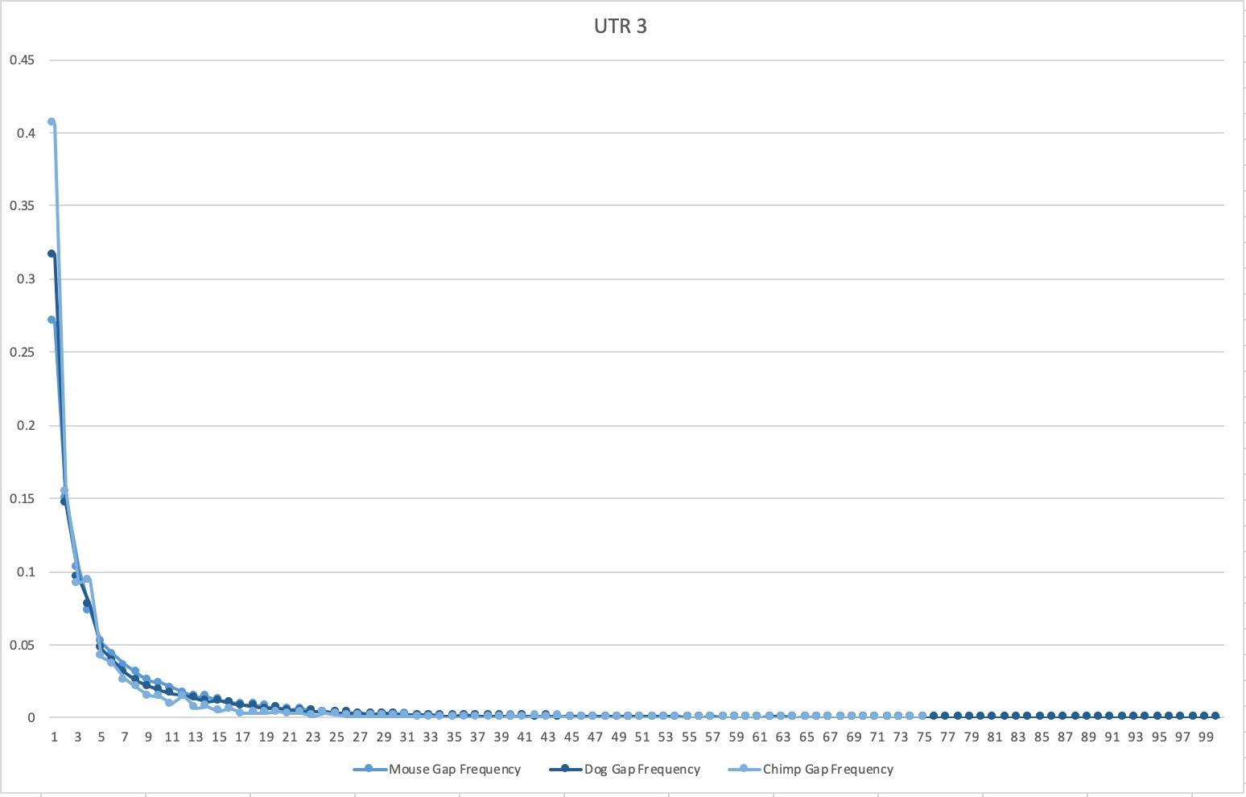
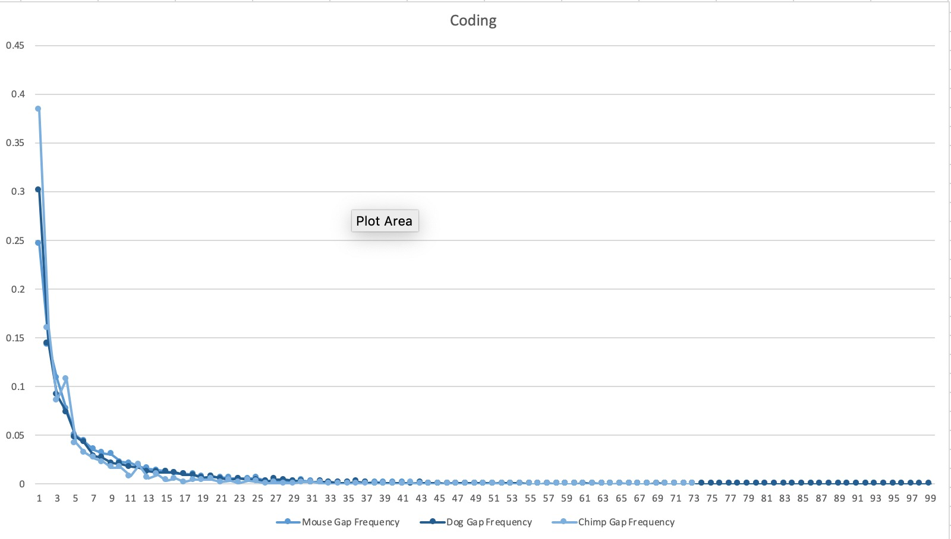

Slide 15
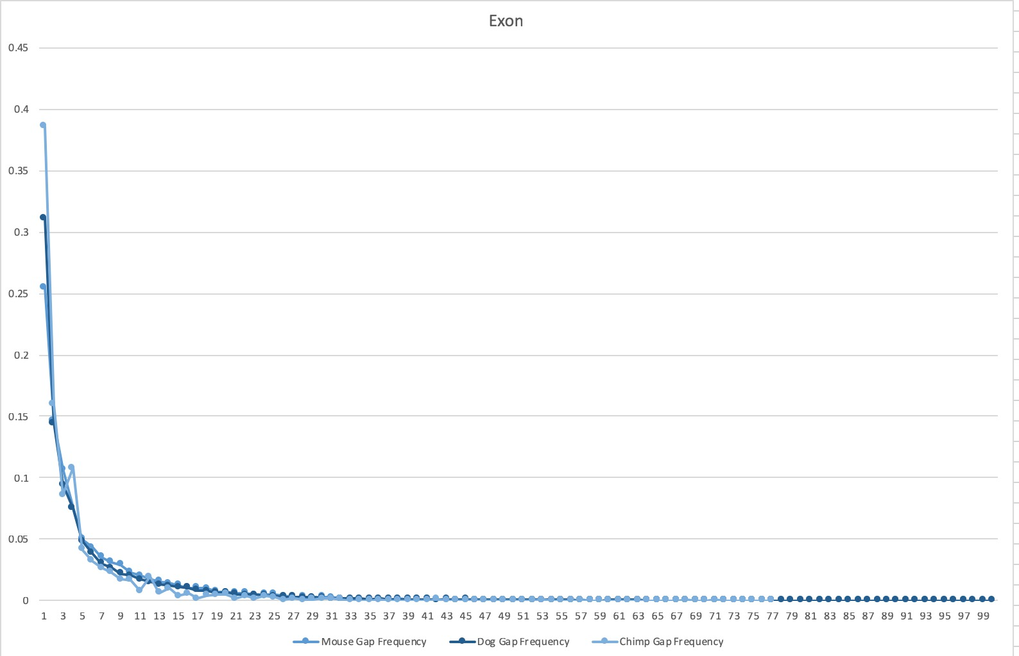
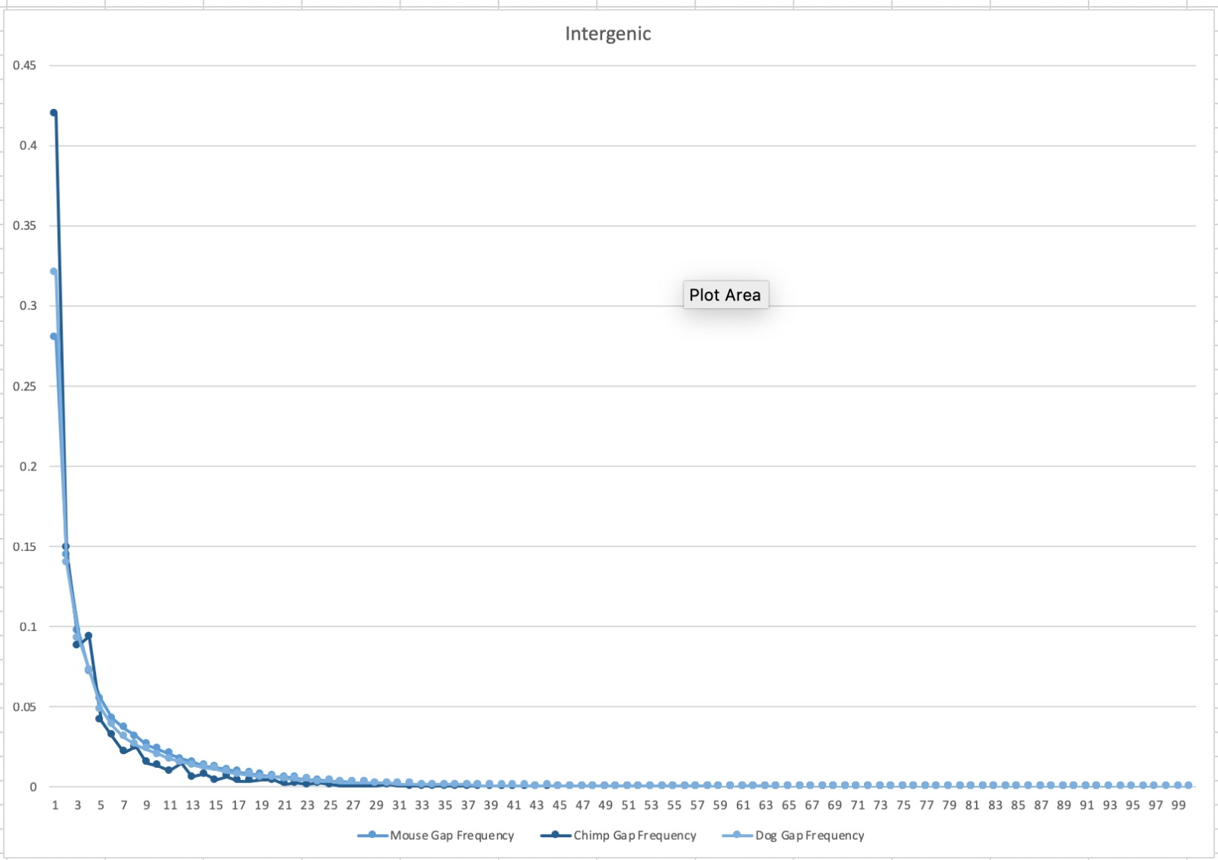

Slide 16
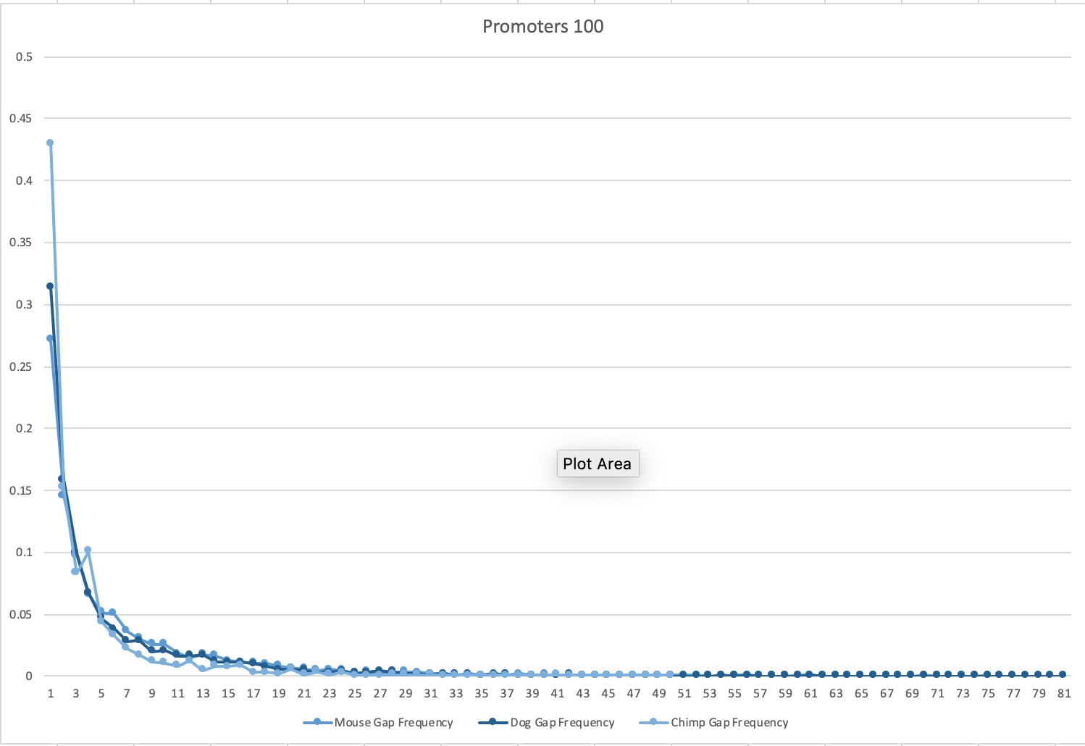
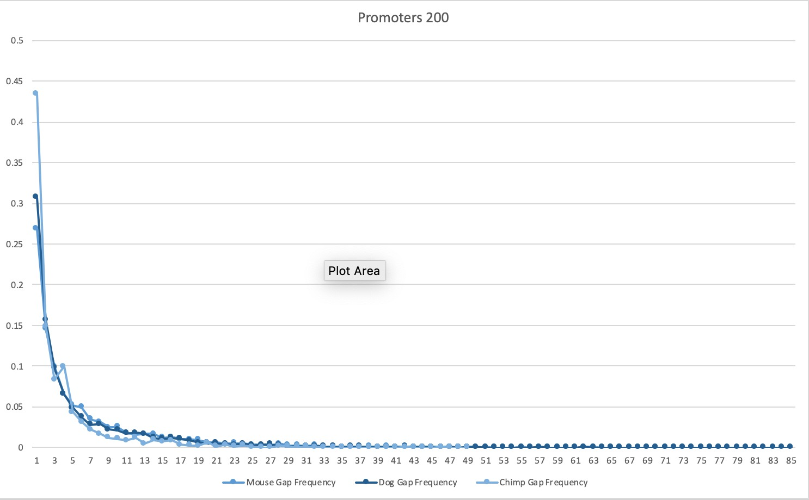
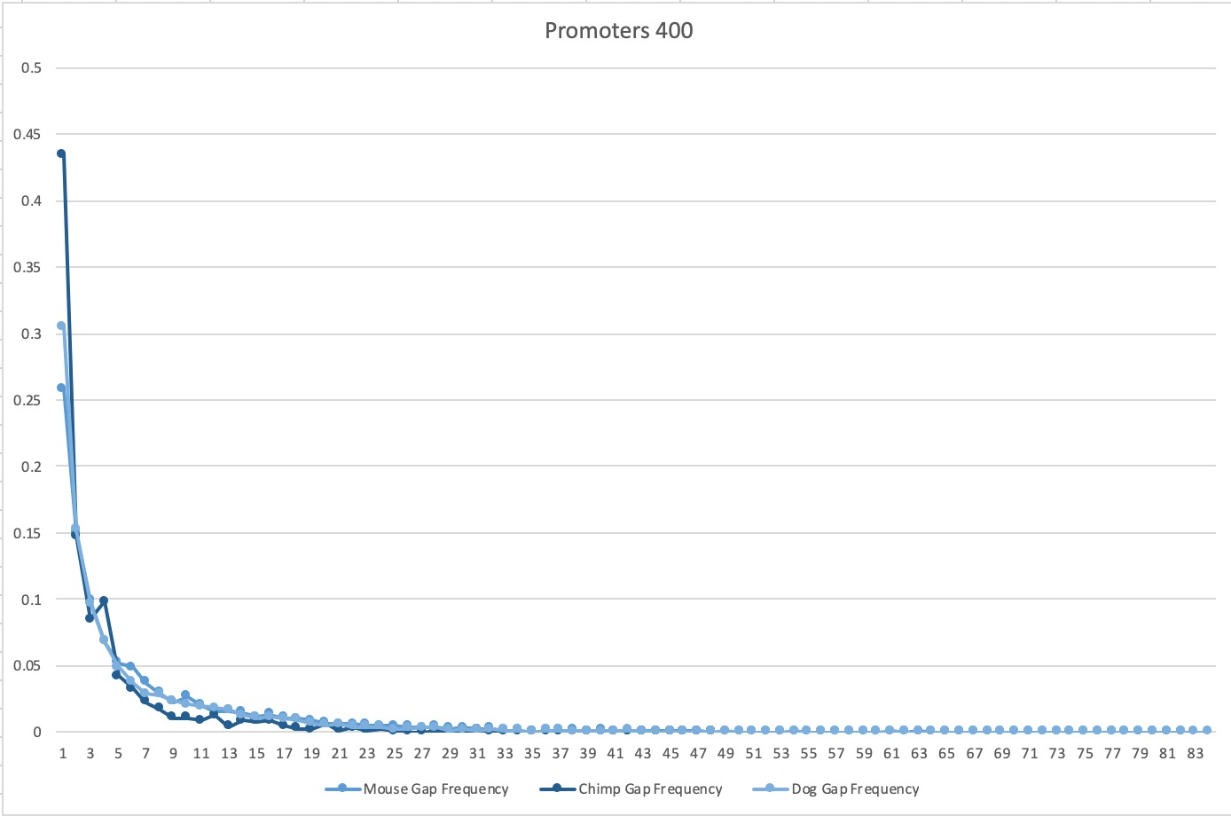
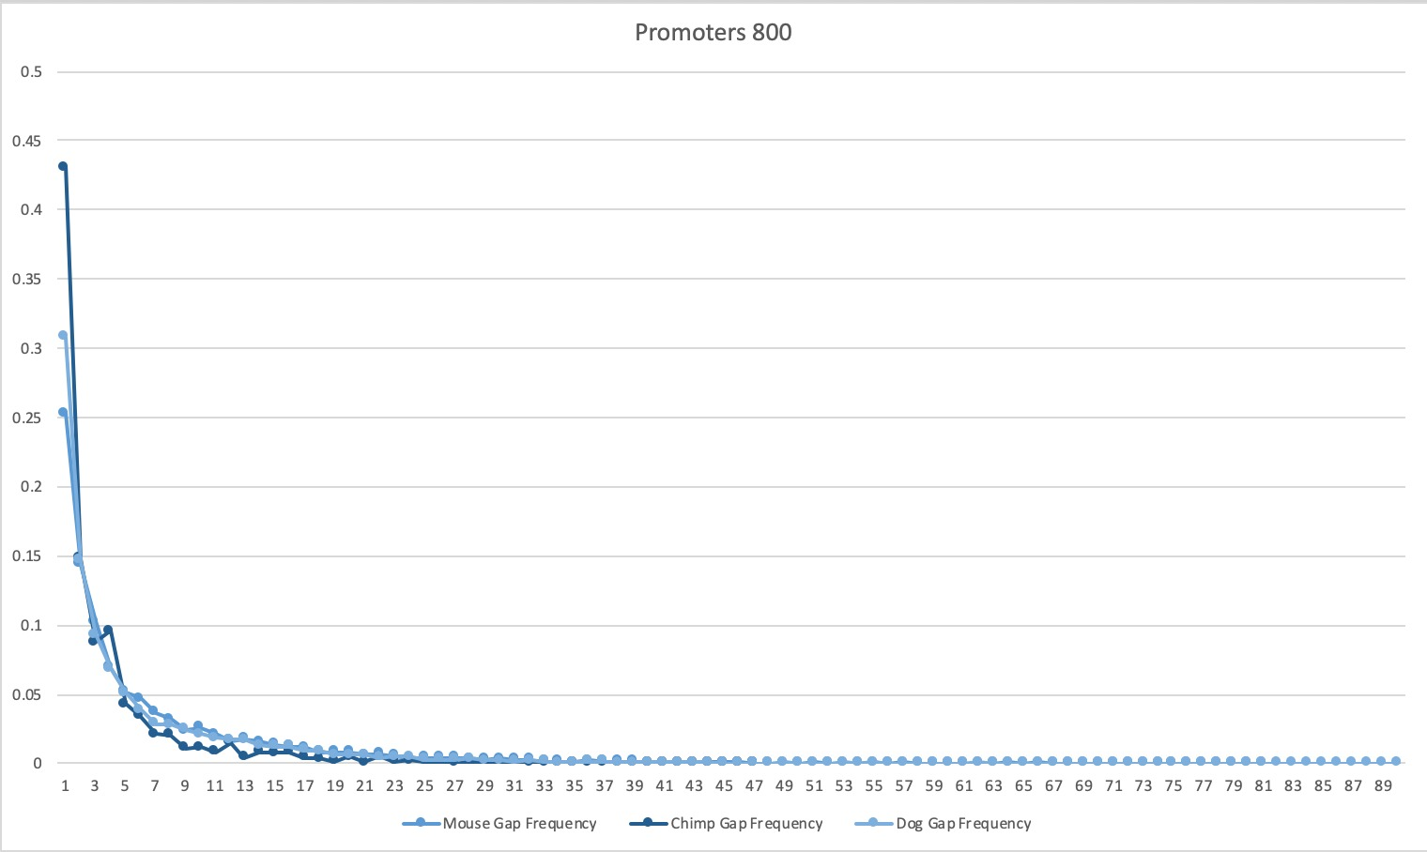

Slide 17
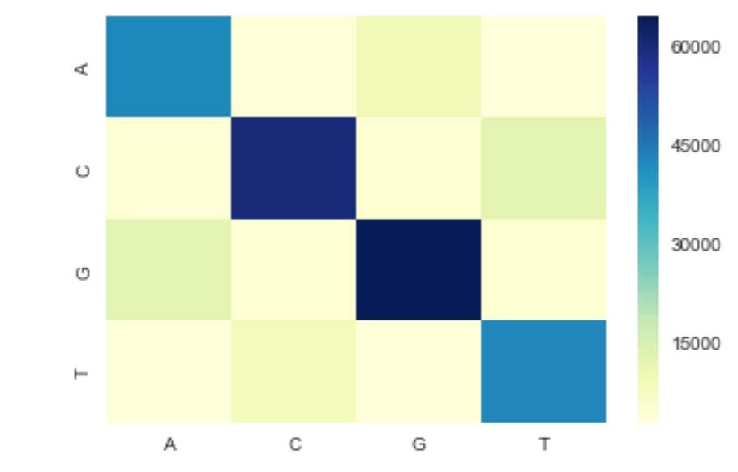
Heatmap of ACGT Ratios

Slide 18
Any Questions?

